Slide 1

OneDrive Hybrid
Buğra Postacı
Escalation Engineer

Slide 2






Sponsors
Main Sponsor
Platinum Sponsor
Venue Sponsor
Silver Sponsor

Slide 3
Ajanda
OneDrive Hybrid - SharePoint On-Prem.
Minimum gereksinimler
Ön Koşullar
Hybrid Wizard
Demo - Hybrid OneDrive and Sites Kullanımı
Bilinen Sorunlar (Known issues)
Hata Ayıklama (Troubleshooting)

Slide 4
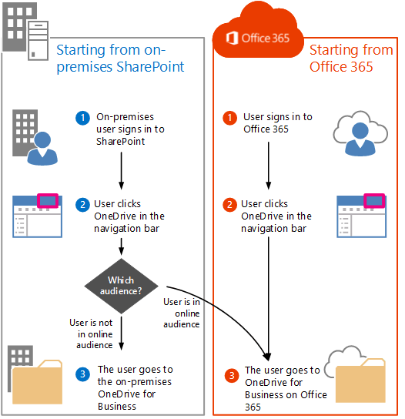
Hybrid OneDrive
Office 365 Plan
SharePoint Online Tenant
OnPrem SharePoint 2013/16/19
AAD sync
Her kullanıcı için O365 Lisansı

Slide 5
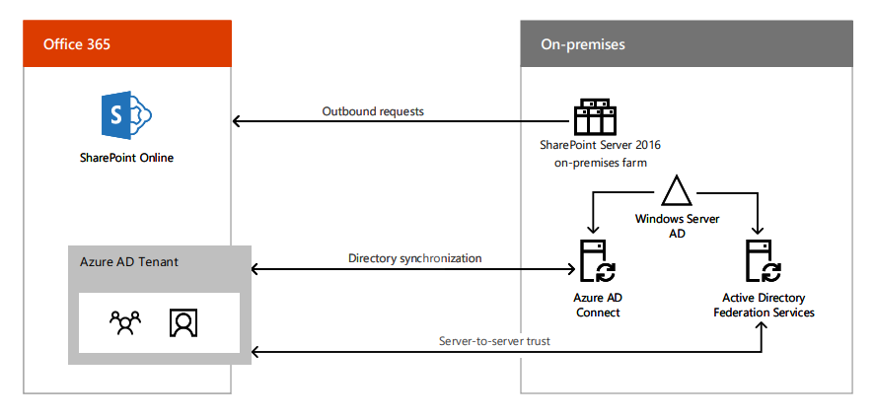

Slide 6
Neden Hybrid OneDrive
Kullanıcı başına 2GB/1TB/Unlimited Depolama alanı seçeneği
15GB Maksimum dosya boyutu
Kolay Erişim, Düşük Bakım maliyeti.
OnPrem Farm yükünün azaltılması
Kolay paylaşım (External Sharing) ve iş birliği (Collaboration).

Slide 7
Minimum Gereksinimler
October 10, 2017, cumulative update for SharePoint Enterprise Server 2013 (KB4011177)
  https://support.microsoft.com/en-us/help/4011177/october-10-2017-cumulative-update-for-sharepoint-enterprise-server
May 8, 2018, update for SharePoint Enterprise Server 2016 (KB4018386)
  https://support.microsoft.com/en-us/help/4018386/may-8-2018-update-for-sharepoint-enterprise-server-2016-kb4018386
Aksi taktirde Get-SPO365LinkSettings cmdlet bulunmuyor.

Slide 8
Ön Koşullar
TCP portları 80 ve 443 dış bağlantı için açık olmalı
Kullanıcılar, Office 365 Azure Active Directory’e senkronize edilmiş olmalı
Azure Active Directory Sync(AAD)
UPA and UPA Synch kurulu ve çalışır durumda olmalı
Personal Site yaratma hakları UPA üzerinde (Create Personal Site, Follow People and Edit Profile, Use Tags and Notes ) kontrol edilmeli.
SharePoint O365 Link Settings ve MySite Host konfigürasyonu
  Set-SPO365LinkSettings -MySiteHostUrl "http://mysites.contoso.com" -RedirectSites $true

Slide 9
Demo

Slide 10
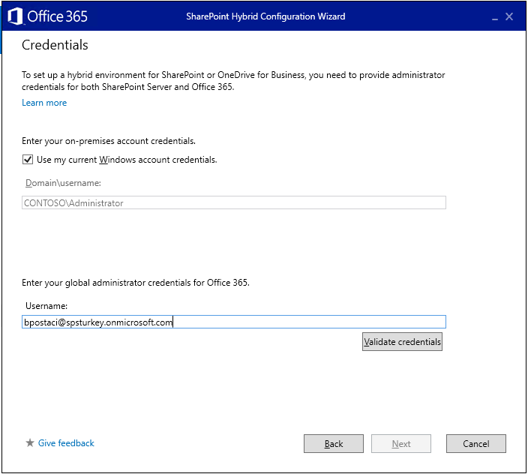

Slide 11
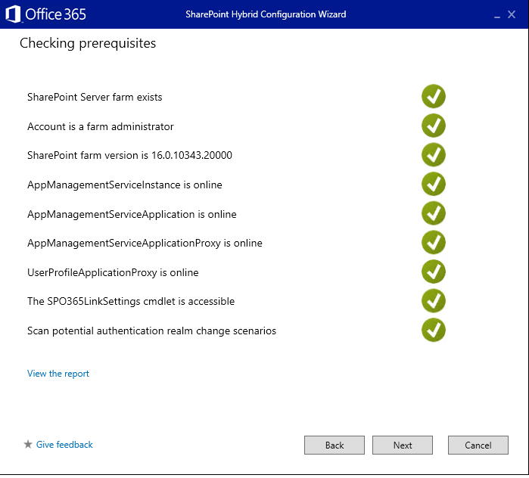

Slide 12
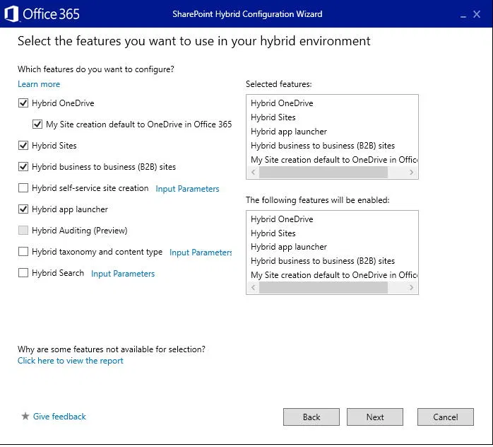

Slide 13
Hybrid Wizard’ın kontrol listesi
SharePoint Server farm var mı ?
User Account , farm administrator hakkı var mı ?
SharePoint farm versiyonu Hybrid Wizard için uygun mu ?
AppMangementServiceInstance , AppMangementServiceApplication , AppMangementServiceApplicationProxy var ve online mı ?
UserProfileApplicationProxy var ve online mı ?
The SPO365LinkSettings cmdlet (used to set the MySiteHostURL) sunucu üzerinde var mı ?
Not: Ayrıca Kimlik Bilgileri «Credentials» sayfasında Office365 Global administrator hesabı kullanılmalı (Sadece SharePoint Admin/Hesap yetkisi yeterli değil).
Notes:
The results of this testing can be viewed as a report if any prerequisite isn't met. If all prerequisites are met you will see green check-marks beside all the prerequisites, and will be able to continue your hybrid configuration
As part of hybrid configuration for Hybrid Sites, the hybrid picker updates the on-premises farm's authentication realm to match the Office 365 tenant context ID. After the authentication realm is changed, existing SharePoint add-ins fail to authenticate. The hybrid picker will attempt to fix this issue automatically.

Slide 14


Bilinen Sorunlar ve Çözüm yolları
Kodu compile etmişler
«ya nasip» demiş
Notes:
İki thread bir olunca, heap seyran olur.
Kodu compile etmişler «ya nasip» demiş.

Slide 15
Bilinen Sorunlar
The SPO365LinkSettings cmdlet is not accessible on the server.
When you run Get-SPO365LinkSettings cmdlet in SharePoint management shell, you receive the following error message:
Get-SPO365LinkSettings : UserProfileApplicationNotAvailableException_Logging :: UserProfileApplicationProxy.UserProfileApplication has null upa
At line:1 char:1
+ Get-SPO365LinkSettings
+~~~~~~~~~~~~~~~~
+ CategoryInfo : InvalidData: (Microsoft.Offic...GetLinkSettings:SPO365GetLinkSettings) [Get-SPO365LinkSettings], UserProfileApplicationNotAvailableException
+ FullyQualifiedErrorId : Microsoft.Office.Server.UserProfiles.Powershell.SPO365GetLinkSetttings

Slide 16
Bilinen Sorunlar
The SPO365LinkSettings cmdlet is not accessible on the server.
If you are using UPA publishing scenario:
The issue occurs because running Hybrid Picker from a consuming farm that consumes the User Profile service application from a publishing farm isn’t supported yet
Or You are not on correct build.

Slide 17
Bilinen Sorunlar
Users are redirected to SPO my site but they receive an error on creating OneDrive site
$ca = Get-spwebapplication -includecentraladministration | where {$_.IsAdministrationWebApplication}
$spsite = $ca.url
$site = Get-SPSite $spsite
$context = Get-SPServiceContext $site
$upsa = New-Object Microsoft.Office.Server.UserProfiles.UserProfileManager($context)
$profiles = $upsa.GetEnumerator()
foreach($profile in $profiles)
{
write-host $profile.PersonalSiteFirstCreationError
write-host $profile.HybridRemotePersonalSiteHostURL
}

Slide 18
Bilinen Sorunlar
After setting Hybrid OneDrive users are still redirected to local my site
Çözüm:
$o365settings = Get-SPO365LinkSettings
$o365settings.OnedriveDefaultToCloudEnabled = $True
$o365settings.Save()

Slide 19
Bilinen Sorunlar
Provider-hosted add-ins stop working and HTTP 401 error after you configure SharePoint farm hybrid features
Çözüm
https://docs.microsoft.com/en-us/sharepoint/support/administration/provider-hosted-add-ins-stop-working-and-http-401-error-after-configure-farm-hybrid-features

Slide 20
Bilinen Sorunlar
Users cannot follow sites in modern view
Microsoft.Office.Server.Social.SPSocialFollowingManager.IsFollowed: Microsoft.Office.Server.UserProfiles.SocialDataStoreException: PersonalSiteNotFound : Personal site does not exist.
Çözüm
You need to create a personal site in onprem my site location using powershell followed by IISRESET on UPA server.

Slide 21
Bilinen Sorunlar
Get an access denied for Global admin when checking permissions in Hybrid Wizard.
Çözüm:
Some tenants use MFA on authenticating users. Disable MFA during running Hybrid Wizard because it’s not supported yet.

Slide 22
Referanslar
https://docs.microsoft.com/en-us/sharepoint/hybrid/plan-hybrid-onedrive-for-business
https://docs.microsoft.com/en-us/sharepoint/hybrid/configure-hybrid-onedrive-for-business
https://docs.microsoft.com/tr-tr/azure/active-directory/saas-apps/sharepoint-on-premises-tutorial

Slide 23

Q&A
*Arama motoruna tüp takarsak, daha az yakar mı ?

Slide 24


